Slide 1
Ultrasound Guided AV Access Cannulation
Liza A. Lucero MSN, FNP-C

Slide 2
US Guided Cannulation
No Relationships to Disclose!

Slide 3
OBJECTIVES
Identify circumstances for USG cannulation?
Investigate whether USG (ultrasound guided) cannulation improves cannulation accuracy.
Advantages and Disadvantages of USG?
Review what evidence exists to support the use of USG?

Slide 4
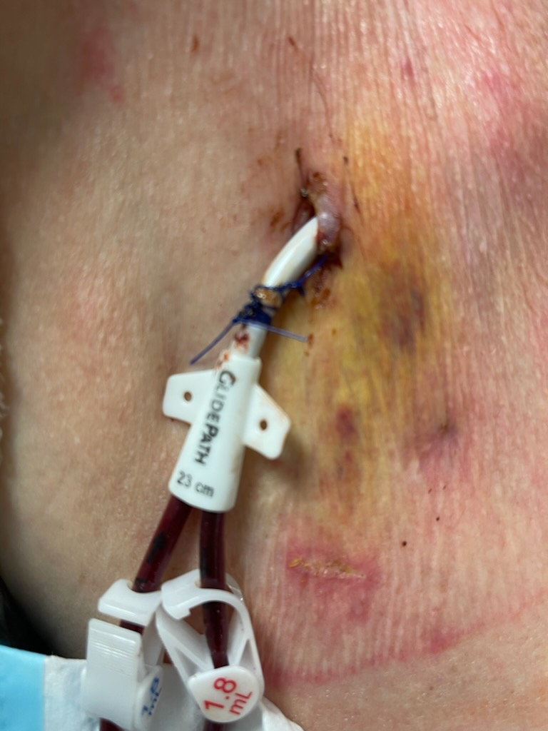
Hemodialysis Access

Slide 5
WHY IS THE CHOICE OF VASCULAR ACCESS SO IMPORTANT?

Slide 6
NKF GUIDELINES
On March 13, 2020, the National Kidney Foundation (NKF) released the Kidney Disease Outcomes Quality Initiative (KDOQI) Clinical Practice Guideline for Vascular Access. Last update was in 2006!
(NKF, 2023)

Slide 7
ESKD LIFE PLAN
The ideal hemodialysis vascular access is one that provides reliable, complication free access to deliver prescribed dialysis and that is also concurrently suitable for a given patient’s needs
(NKF, 2023)

Slide 8
WHY USG CANNULATION?
Access Damage & Treatment Delay
Repeated cannulation of same site & Increase risk of aneurysm
Hematoma & Thrombosis
Access Failure and placement of Tunneled dialysis catheter (TDC)

Slide 9
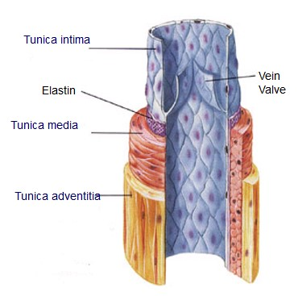
ACCESS DAMAGE
Cannulation itself causes microtrauma which leads to hyperplasia of the intima and lead to vessel stenosis.
Infusion Therapy Institute, 2023

Slide 10
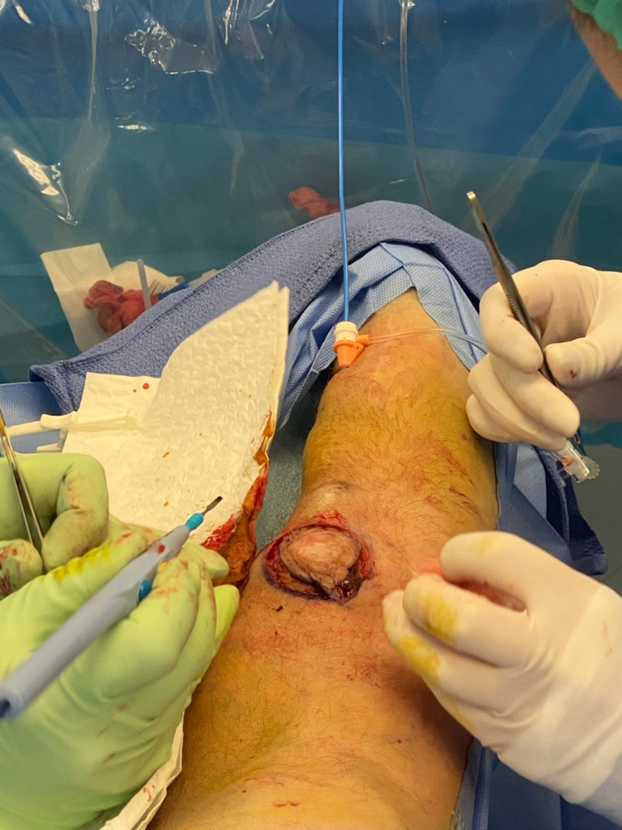
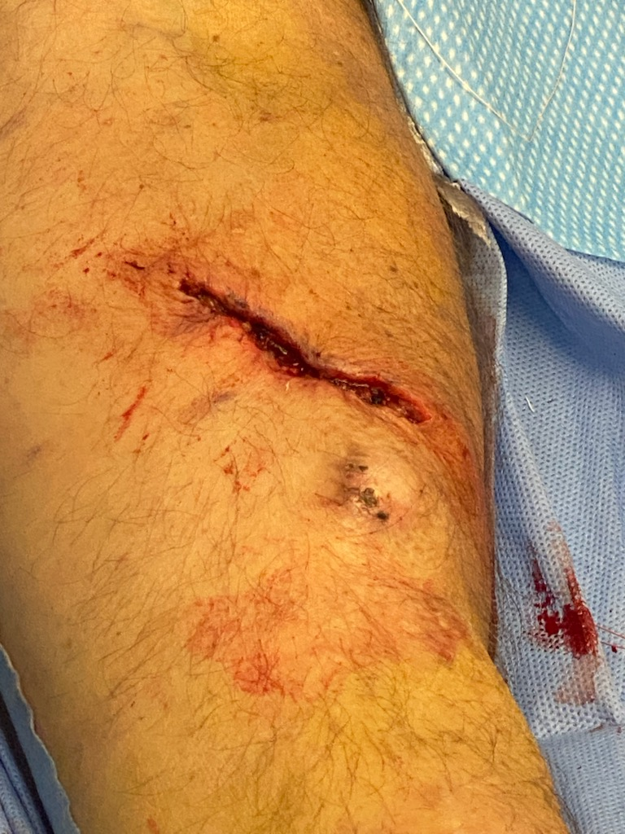
REPEATED CANNULATION & ANEURYSM
Cannulation in the same area will result in a weakened vessel forming Aneurysms.
Banerjee, 2023

Slide 11
HEMATOMA/THROMBOSIS
Hematomas
Thrombosis
Insertion into the wall can lead to hematoma
Increased risk of thrombosis, and loss of access.
Radiopaedia, 2023

Slide 12
CHANGES WITHIN THE ACCESS
Intimal hyperplasia and shear stress of the wall are primary cause of stenosis.
Blood flow has an effect on endothelial function.
Direction of the needles.
Nalesso et al., 2020

Slide 13
ACCESS FAILURE AND TDC PLACEMENT
Primary failure- where in 3 months the AVF is not able to be cannulated.
Secondary failure is when the AVF/G is no longer for suitable cannulation- due to many issues, but DAMAGE is one of them.

Slide 14
WHAT OTHER COMPLICATIONS EXIST
Co-morbidities
Diabetes
Vascular Disease
Female Gender
Age >65
Obesity
Tadashi et al., 2016

Slide 15
POINT OF CARE ULTRASOUND USE
Schoch et al., (2020) Described POCUS as " A useful adjunct to other vascular access clinical assessments particularly for vessels that are new, small, mobile or tortuous."
Literature review was done to see what was currently available, what gaps existed.

Slide 16
HOW DO WE CANNULATE AVF/G?
BLIND (TRADITIONAL) CANNULATION

Slide 17
USG
Recommended by the Canadian Association of Nephrology Nurses and Technologists' for the management of vascular access.
They state that "blind cannulation results in suboptimal needle placement and potential AVF complications"
Schoch et al., 2020

Slide 18
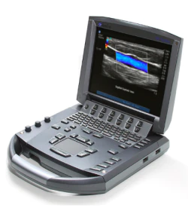
POINT OF CARE ULSTRASOUND USE
21Publications were reviewed.
From 2009-2018
11 Full Text
10 Published Abstracts

Slide 19
UTILIZATION OF POCUS
Assess New AVF Maturation
Identify Landmarks & Abnormalities
Assessing Alternate Cannulation Sites
New AVF Cannulation
Difficult Access Cannulation
Eves et al., 2021

Slide 20
BENFITS OF POCUS
Increasing Cannulation Accuracy
Successful Cannulation Through Stents
Patient Self-Cannulation Training
Schoch et al., 2020

Slide 21
FINDINGS OF POCUS
Reduced Cannulation complications
Detection of vessel wall needle infiltrations w/o s/s
Identification of abnormalities that are not visible on the skin
Schoch et al., 2020

Slide 22
BARRIERS
Training
RN or CHT
Who's going to train them? And how long?
Determining Competency.
Time
How much more time will it add on to the day?
Availability- Does every unit get one?
Affordability- How much is this going to cost?
Reluctance to learn New Technology- Experience vs. Machine.
Schoch et al., 2020

Slide 23
USG FOR CLINICAL MANAGEMENT AND NEEDLE POSITION
Nalesso et al., 2020 Conducted a study- of the 44 patients in the study, findings of needle position were significant.
88.6% of arterial needles and 75% of venous needles were incorrectly positioned inside the vessel.
18.2% which was 16 needles were correctly positioned in the center .

Slide 24
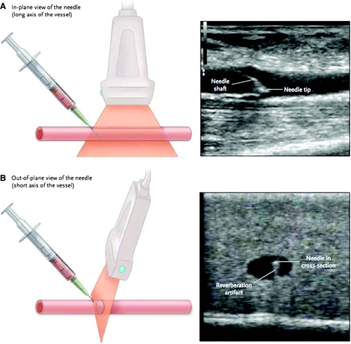
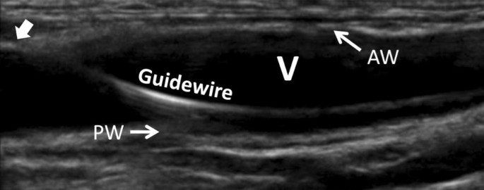
Wiley online library, 2023

Slide 25
CANNULATION OF DIFFICULT AVF
Eves, et al (2021) Conducted a study 32 of 185 consented.
Questionnaires were completed by patient's r/t measuring discomfort or anxiety.
Questionnaires completed by staff r/t perception of USG cannulation.

Slide 26
CANNULATION OF DIFFICULT AVG
USG cannulation resulted in a significant reduction of additional and absolute number of skin punctures (P=0.015). Especially more difficult ones.
It took over a minute more to achieve 2 needle cannulation.
No difference in discomfort by patient.
No difference in their lidocaine regimen.
25% of staff felt USG was neither slower nor faster, while 50% felt it took longer.

Slide 27
IN CONCLUSION
USG cannulation does have room in the future of hemodialysis.
It may help with reduction of multiple cannulations especially for those challenging AVF/Gs.
Reduction of discomfort and anxiety.
Increase confidence
Avoid damaging accesses
Avoid TDC

Slide 28
IN CONCLUSION
Barriers:
Accessibility
Setting up training
Affordability
Busy units
Staffing
Not enough studies

Slide 29
Thank You

Slide 30
REFERENCES
Artery and vein models. Retrieved on February 19, 2023 from https://healthiack.com/encyclopedia/veins-diagram/attachment/veins-diagram-54
AVF Thrombosis. Retrieved on February 19, 2023 from Radiopaedia.org, the peer-reviewed collaborative radiology resource
Banerjee (February 22, 2023) Case discussion of aneurysms in both AVF/AVG.
Eves J, Cai, P, et al. (2020) A Randomized clinical trial of ultrasound guided cannulation of difficult fistulae for dialysis access. J. of Vascular Access 2021: 22(4) 635-641.

Slide 31
References
Nalesso F, Garzotto F , et al ., (2020) Ultrasound for the clinical management of vascular access cannulation and needle position in hemodialysis patients. Ultrasound in Med & Bio.46 (2) 455-59.
Needle position within vein . Retrieved on February 20, 2023 from Wiley Online Library | Scientific research articles, journals, books, and reference works
Schoch, M, Bennett, P, et al., Point-of care ultrasound use for vascular access assessment and cannulation in hemodialysis: A scoping review. Seminars in Dialysis (2020)
Tadashi, K, Mayumi, T et al., (2016), Renal replacment therapy . 2:7

