Slide 1
Methicillin Resistant Staph Aureus Bacteremia
Dr. Jayant Kumar
15th Annual SW Nephrology Symposium

Slide 2
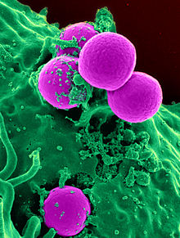
No Conflict of Interest Objectives – name 2 complications that could occur due to MRSA Bacteremia
Notes:
This is the question that your experiment answers

Slide 3
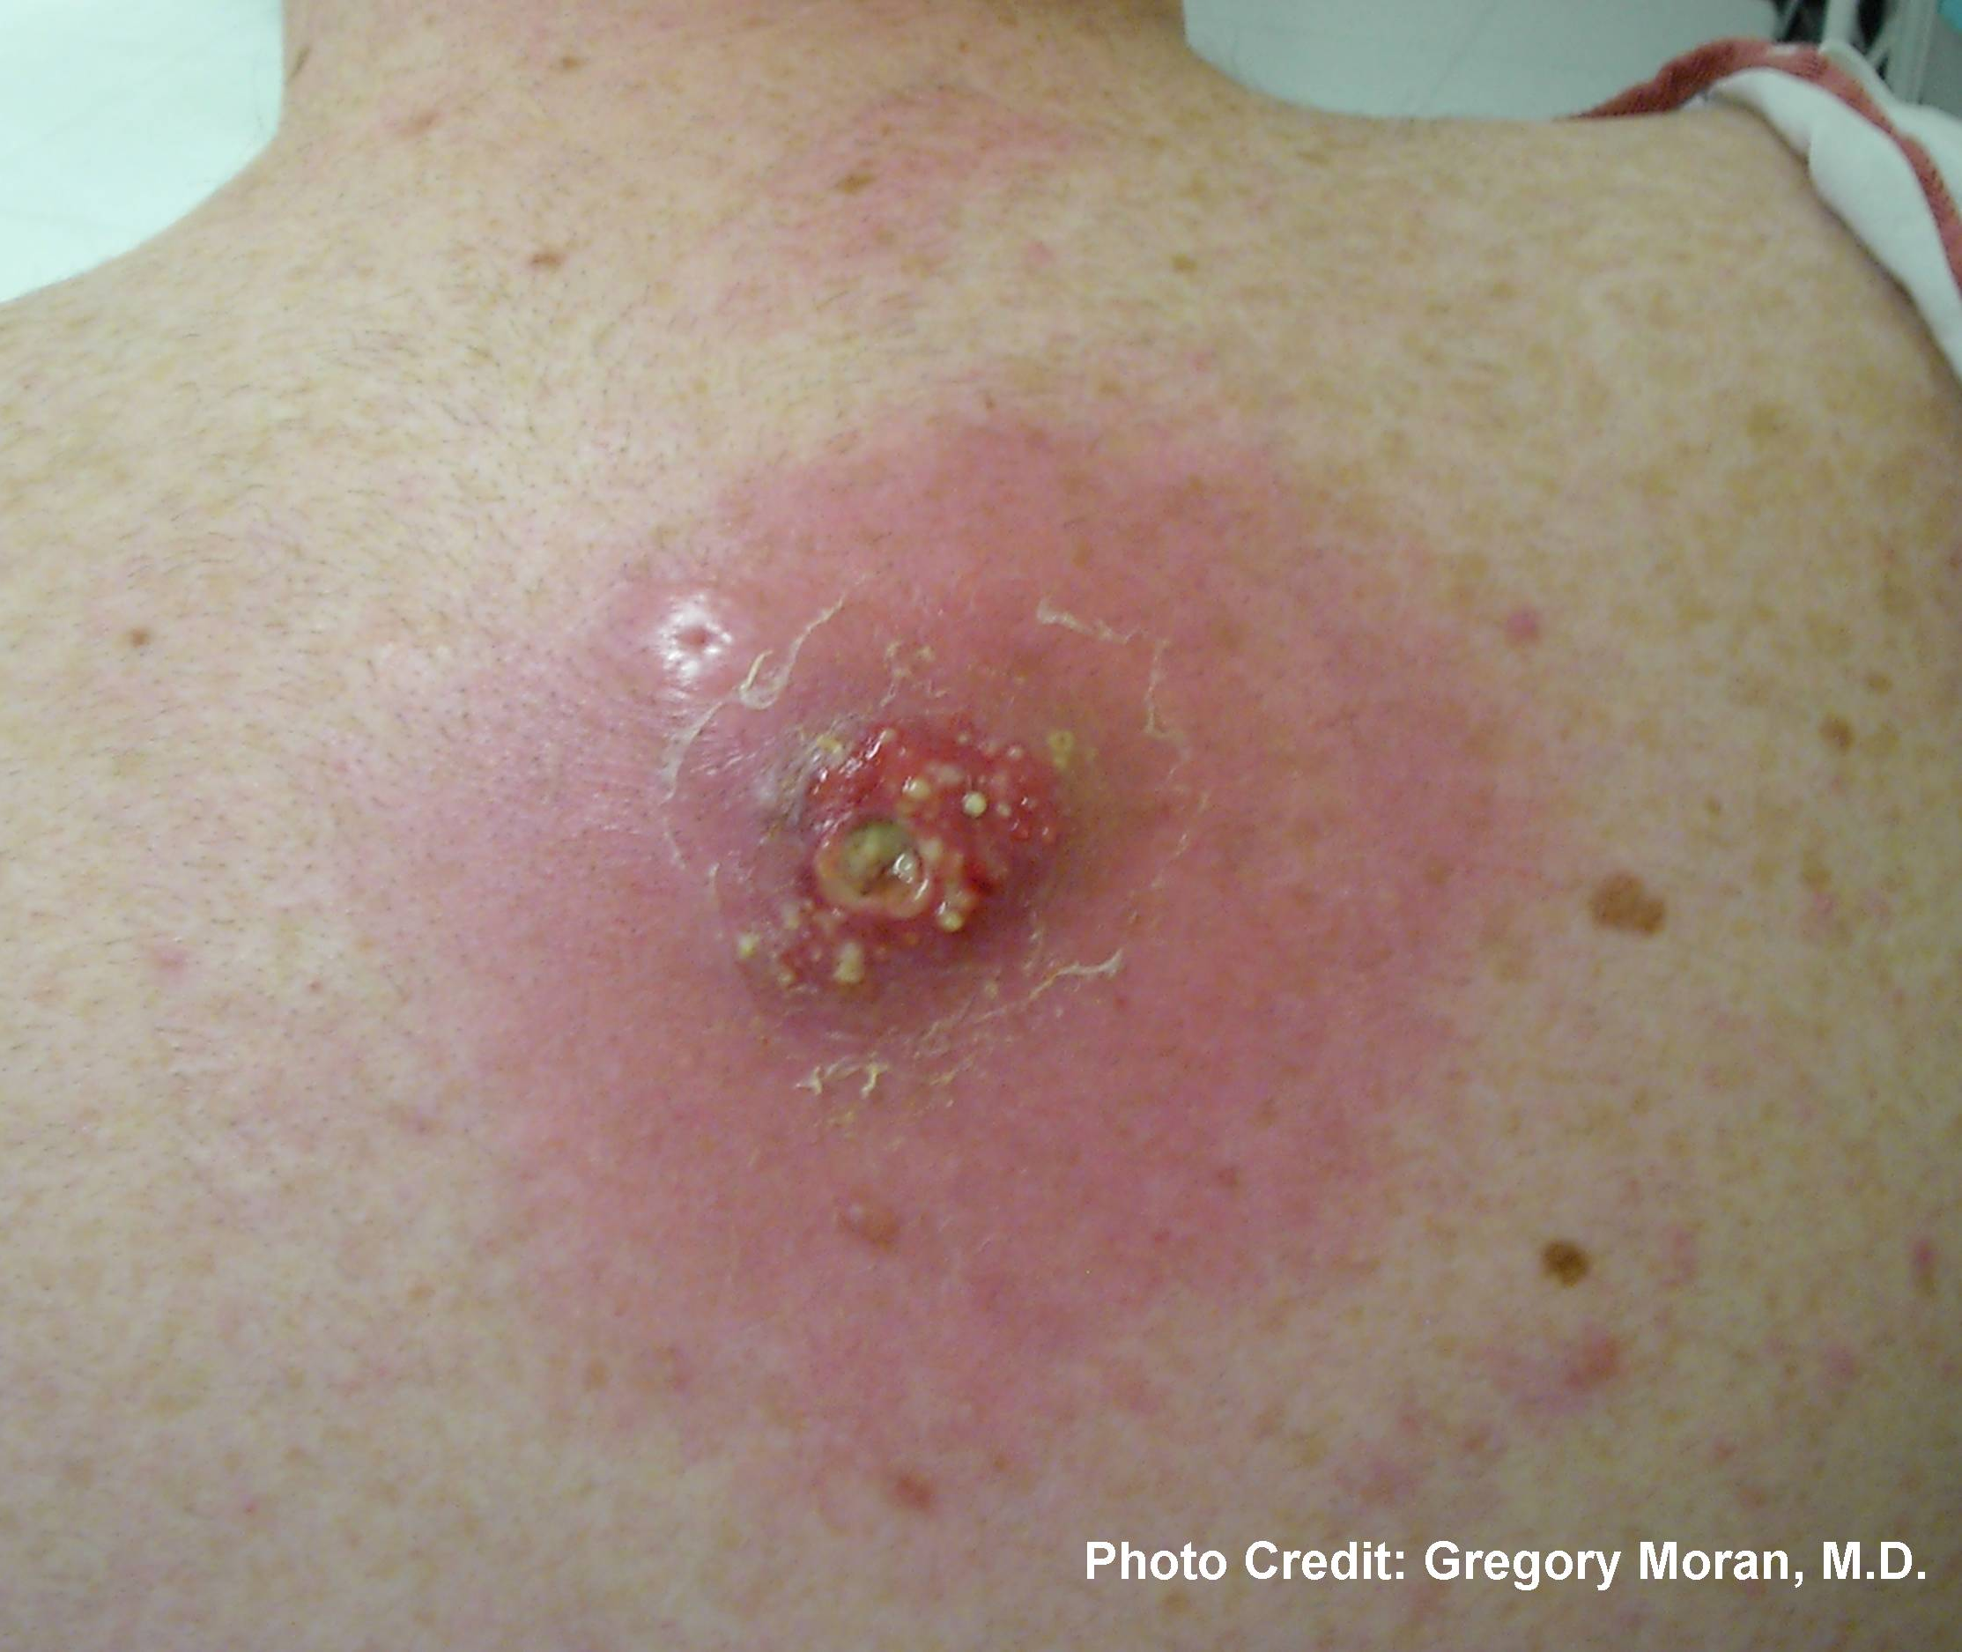
Picture of MRSA pustule
Staph aureus quickly invades tissue, multiplying quickly and has a rapid dissemination throughout the body.
The major defense against tissue invasion is opsonophagocytosis which is inhibited the polysaccharide capsule of staph aureus.
S. aureus also colonizes across the host tissue and persists or develops a biofilm.
Dialysis catheters disrupt the normal skin barrier and form a gateway for bacterial entry into the bloodstream.
Notes:
Summarize your research in three to five points.

Slide 5
Add your answer / solution here
Hypothesis
Notes:
Establish hypothesis before you begin the experiment. This should be your best educated guess based on your research.

Slide 6
Materials
Materials (detailed list) | Quantity (be specific)
Item | Amount
Item | Amount
Item | Amount
Item | Amount
Item | Amount
Item | Amount
Item | Amount

Slide 9
Colonization and Transmission
S. aureus colonizes the nares of 28-32% of the US population. MRSA nasal colonization rates range from 0.9- 1.5% in the US.
Elevated risk of MRSA colonization is highest in athletes, prisoners, military, children, people living in urban, underserved areas, people with an indigenous background, pet owners, livestock workers, people with prior MRSA infection, individuals with HIV or cystic fibrosis and people with frequent health care contact (dialysis patients).
Determining how long MRSA colonization persists after infection is difficult. It has been cultured up to 6 months after an infection. It can also be cultured from household products such as phones, gloves, notebooks, pens etc.
MRSA colonization can increase infection risk by as much as 25%. The annual mortality rate caused by sepsis is 100 to 300 times higher in patients with ESRD than in the general population.
Turner et al (2019). Methicillin-resistant staphyloccus aureus: an overview of basic and clinical research. Nature Reviews- Microbiology. 17, 203- 218.

Slide 10
MRSA Colonization - reducing the risk of infection
Multiple studies have shown that the traditional MRSA nares swabbing can be as low as 66% accurate. PCR tests more accurate (but more expensive and more false positive result). Swabs with nylon-flocked tips outperform traditional rayon swabs.
Screening of multiple body sites has been shown to improve detection with 2-3 sites as optimal for detection.
For MRSA positive patients, most health care settings initiate strict isolation and elimination of the MRSA colonization.
Infection prevention measures include screening, contact isolation and good hand-hygiene practices. Topical nasal mupirocin alone failed to reduce subsequent MRSA infections, perhaps due to colonization at other body sites.

Slide 11
MRSA transmission and resistance
Any item that comes in contact with skin can transmit MRSA – such as pens, white coats, mobile phone etc.
The Staph aureus genome consists of mobile genetic elements (MGEs) which lead to different S. aureus strains and antibiotic resistance.
The emergence of vancomycin resistance is the most feared genetic change to MRSA .
S. aureus exhibits 2 forms of vancomycin resistance: Vancomycin-intermediate (VISA) tends to emerge with repeated or prolonged course of vancomycin treatment.
This is seen as higher vancomycin minimum inhibitory concentrations (MICs).
Vancomycin-resistant S.aureus has been shown to occur through genetic changes from vancomycin-resistant Enterococcus faecalis. Fortunately, this is a rare occurrence with only few recorded cases of vancomycin-resistant S. aureus.

Slide 12
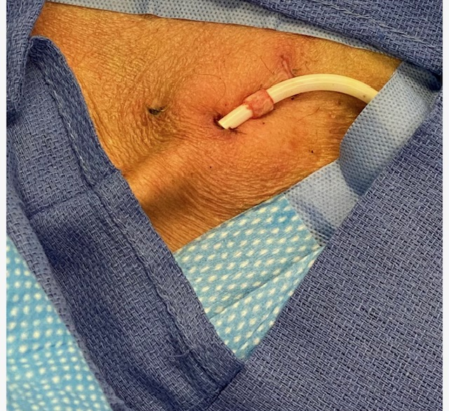
Exit site infection

Slide 13
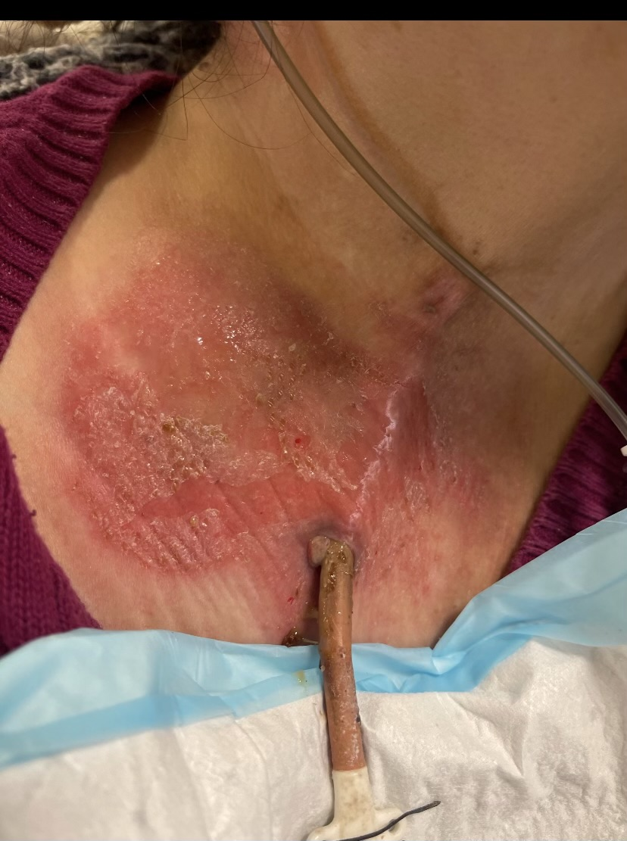
Exit site infection

Slide 14
Start dialysis with TDC

Slide 15
On HD with failing access

Slide 16
CVC vs AVF/AVG

Slide 17
MRSA Treatment
Use intravenous vancomycin for uncomplicated bacteraemia caused by MRSA (strong recommendation).
When vancomycin is contraindicated use linezolid as an alternative first-line choice of treatment (strong recommendation).
When first-line agents are contraindicated consider daptomycin or teicoplanin (weak recommendation).
Do not use co-trimoxazole alone as a first-line agent for MRSA bacteraemia, however, consider using it as an oral step-down when the MRSA isolate is known to be susceptible (weak recommendation).
Consider a minimum duration of 14 days of antibiotic therapy for uncomplicated bacteraemia and a minimum duration of 28 days for complicated bacteraemia caused by MRSA (weak recommendation).

Slide 18
Access associated sepsis, management
All non-tunneled catheters causing CLABSI should be removed promptly
For TDC, exit site infections can be treated with short course of topical or systemic antibiotics
All tunnel infections will require catheter removal due to a high risk of CLABSI
Persistent symptoms or culture for more than 36 hours after antibiotics: TDC removal
Organisms S. aureus, Pseudomonas or fungi: TDC removal
Duration (uncomplicated) 14 days

Slide 19
MRSA Bacteremia
Daptomycin is the only other FDA approved first-line agent for MRSA bacteremia or endocarditis.
Daptomycin is inactivated by pulmonary surfactant so it should not be used in MRSA bacteremia secondary to pneumonia.
There are also MRSA bacteremia strains that are less susceptible to Daptomycin particularly in persistent MRSA bacteremia, subtherapeutic dosing and extensive prior vancomycin courses.
Studies are in place for drugs to use in the above cases. Adjunctive rifampin has no role in MRSA bacteremia or endocarditis in a recent study nor adjunctive gentamycin.
Current guideline recommend treating for 4-6 weeks from first negative blood culture for complicated MRSA bacteremia and 6 weeks for endocarditis.

Slide 20
Osteomyelitis from MRSA bacteremia
S. aureus often forms a biofilm that complicates the treatment of bone, joint and prosthetic-related infections. Vancomycin remains the first-line therapy despite poor bone penetration and failure rates as high as 35-46%.
In adults, initial MRSA osteomyelitis is IV for 2 weeks and then looking at studies to evaluate switching to oral. However, in MRSA vertebral osteomyelitis, IV antibiotic duration less than 8 weeks may be associated with increased risk of recurrence.

Slide 21
Clinical Course of MRSA Bacteremia
Almost all dialysis patients with SAB have fever at presentation, approximately 20% have hypotension and approximately 5% have altered mental status or present with heart failure symptoms.
CR-BSI is infrequently associated with an exit-site infection. Fever associated with a VA infection, generally occurs well into the dialysis session - after 60 minutes.
SAB has a 43% complications: metastatic or extensive local infections, septic embolism , increased mortality or early recurrence, infective endocarditis.
Complicated course: persistent bacteremia beyond 48 hours, persistent fever beyond 72 hours, community acquired, and acute skin infection.

Slide 22
Treatment
Blood cultures 2 sets of aerobic and anaerobic bottles.
Early antibiotic treatment – treat with either vancomycin or daptomycin IV and gram negative coverage until culture results finalize.
Echocardiogram (if SAB).
Removal of catheter, prosthetic graft or other infected foreign body. Attempts to salvage the catheter with antibiotic lock solution (with systemic antibiotics) is associated with a high failure rate. No overwire HD catheter exchange.
Monitor vancomycin trough levels with level 15 to 20 mg/L. Administer during the last hour of HD or after dialysis. Most studies recommend a loading dose of vancomycin of 15mg/kg or up to 25 to 30 mg/kg may be required.

Slide 23
HD Catheter care
Avoid Catheters but especially femoral location and non-tunneled HD catheters.
Hand hygiene is critical. Dressing type is unrelated to catheter infections.
2% chlorhexidine solution is the preferred skin antiseptic – MUST allow to DRY before applying dressing.
SCRUB the HUB before anytime the HD catheter is accessed – I.e. before the patient gets up to the bathroom and when reconnecting.
Use of aspirin – has an inhibitory effect on the expression of a-toxin and fibronectin=binding adhesion in S. aureus. The risk reduction was dose dependent and seen with dosages >325mg/day.

Slide 24
Blood Culture results from 2 sets – Specimen # for first aerobic/anaerobic set

Slide 25
Blood Culture results from 2 sets – Specimen # for second aerobic/anaerobic set - What is the organism?

Slide 26
Wound Culture – What is the organism

Slide 27
Blood Culture 1st Set – note the MIC

Slide 28
Note the Second Set of Blood Cultures – what is the organism and anything unusual with this sensitivity

Slide 29
Note this is positive in anaerobic bottle only. How do you interpret this and what do you do?

Slide 30
Buttonhole and MRSA sepsis
All patients should wash their hands and fistula limb with soap and water prior to cannulation.
0.5% - 2% chlorhexidine gluconate with 70% isopropyl alcohol should be used to clean the cannulation sites.
Cannulation sites should be disinfected immediately before and after scab removal.
Abandon buttonhole usage it gram + sepsis is confirmed or suspected

Slide 31
Vancomycin Dosing
Vancomycin serum trough concentrations of 15–20 mg/L are recommended to improve penetration, increase the probability of obtaining optimal target serum concentrations and improve clinical outcomes.
the revised guidelines recommend monitoring on the basis of predialysis serum concentrations and extrapolating these values to estimate the AUC. Maintaining predialysis concentrations between 15 and 20 mg/L will likely translate to a 24-hour AUC of <600 mgh/L, which will achieve the target AUC/MIC ratio of 400–600, assuming the MIC is ≤1 mg/L

