Slide 1
What does the mouth have to do with heart health?
Christine Cogil, DNP, FNP-BC
14th Annual SW Nephrology Symposium

Slide 2
Nothing to declare!

Slide 3
Objectives
Demonstrate association between oral health and cardiac disease
Recommend preventive oral care measures to limit cardiac events

Slide 4
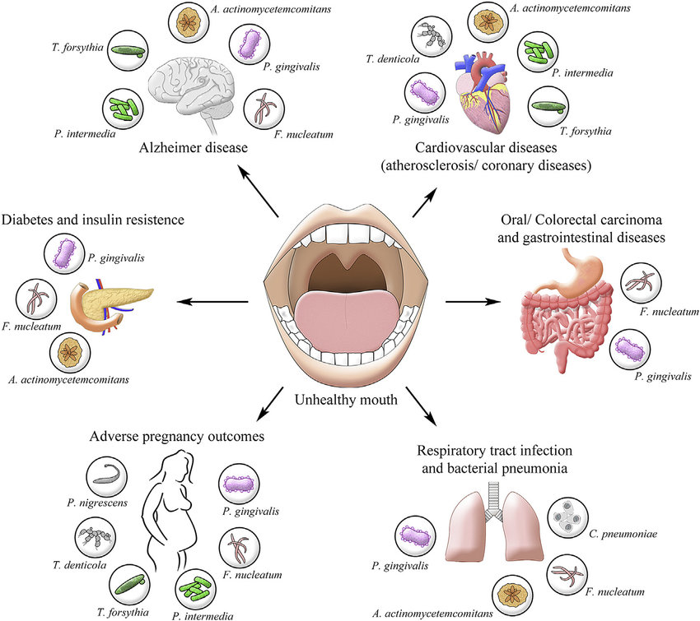
The Oral – Systemic Connection

Slide 5
Is there a direct connection between the mouth and cardiac disease?
Periodontitis and cardiac disease are multifactorial
Proposed Theories for Connection
Bacteria causing periodontitis are found in coronary artery plaque. Does this bacteria damage intimal surface of cardiac vessels causing inflammation?
Does the inflammation from periodontal disease set result in an inflammatory cascade causing vascular damage?
Is there a third factor like smoking that is a risk factor for both periodontal and cardiac disease?
https://www.health.harvard.edu/diseases-and-conditions/gum-disease-and-the-connection-to-heart-disease

Slide 6
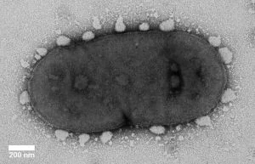
The VILLAIN: Periodontitis AKA Gum Disease
Porphyromonas
Gingivalis
A gram negative, anaerobic, non-motile, asaccharolytic rod

Slide 7
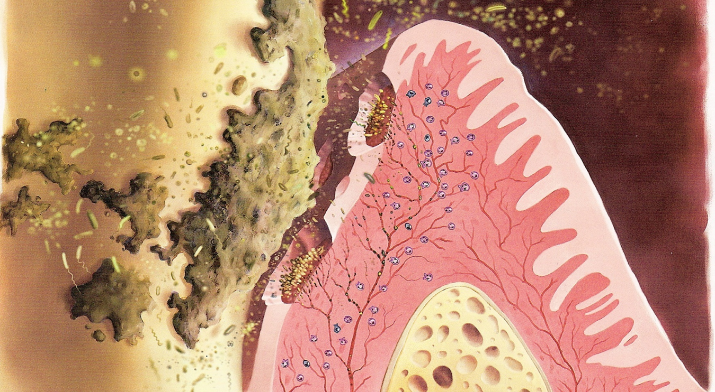
Prevalence of Periodontal Disease (PD)
CDC reports adults with periodontitis
47.2% of adults 30 years and older
34.4% Nonsevere PD
8.5% Severe PD
70.1% of adults 65 years and older
More common in men than women
Highest prevalence in:
People with less than high school education
Current smokers
African American population
Eke, P. I., Thornton-Evans, G. O., Wei, L., Borgnakke, W. S., Dye, B. A., & Genco, R. J. (2018). Periodontitis in US adults: National health and nutrition examination survey 2009-2014. The Journal of the American Dental Association, 149(7), 576-588.
Notes:
Hormone changes affect oral cavity
Teeth may loosen during pregnancy (progesterone and relaxin effects)
Shift in oral flora and decreased immune response can aggravate gingivitis

Slide 8
Gum Disease Progression from Gingivitis to Periodontitis

Slide 9
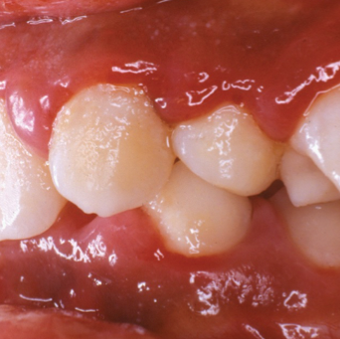
Gingivitis Causes
More common in people:
Who don’t brush teeth daily
Have diabetes
Who are pregnant
Use street drugs regularly
On medication for seizures
Use calcium channel blockers
Notes:
Other causes of gingivitis include:
Poor oral hygiene
Phenytoin (Dilantin)
Valproic acid
Cyclosporines
Calcium channel blockers
Gingival hyperplasia can be surgically treated. It is painful and reoccurrence is expected.
This will progress into periodontitis if not addressed
Factors influencing gingivitis
Tobacco use (inclusive of chewing tobacco)
Diabetes
Low socioeconomic status
African American ethnicity

Slide 10
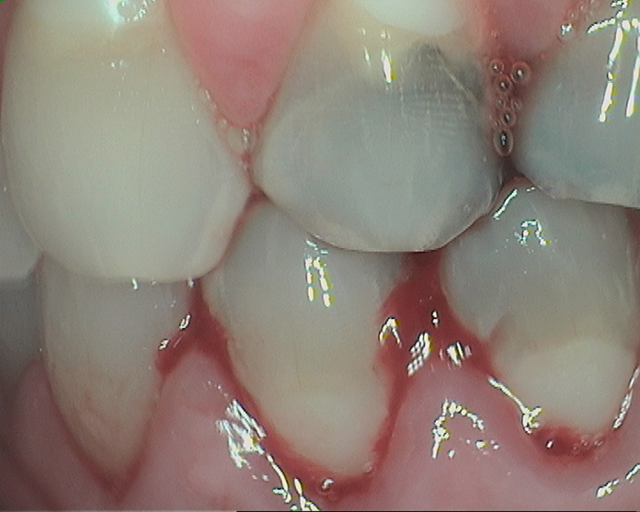
Gingivitis Clinical Signs
Bad breath or bad taste
Red or swollen gums
Tender or bleeding gums
Gums pull away from teeth
Sensitive teeth

Slide 11
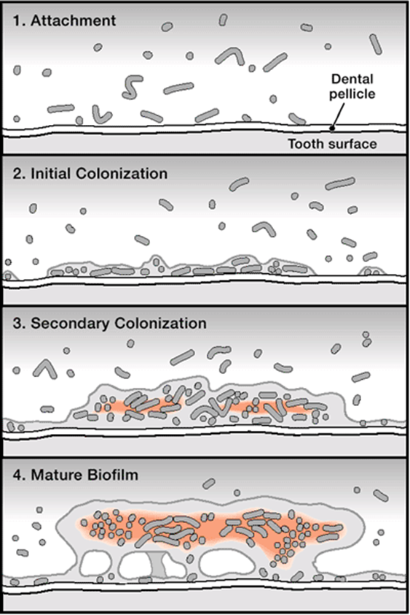
Biofilm (Plaque) Development
Formation of dental pellicle and attachment to tooth surface
Initial/Primary colonization
Normal/healthy oral flora
Non-pathogenic
Secondary Colonization
Increase in quantity
Shift in composition
Mature biofilm
It all Starts
with
Biofilm
Build Up
Notes:
Reminder: rationale for OHI

Slide 12
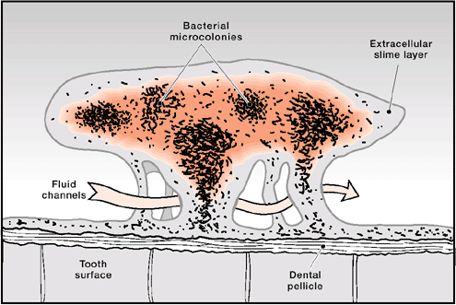
Biofilm Structure
Well organized community
Protected by extracellular slime layer
More difficult to kill than planktonic (floating) bacteria

Slide 13
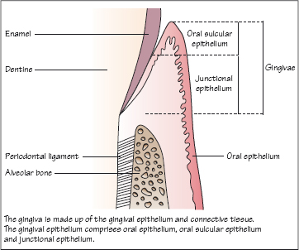
Review of Periodontal Anatomy

Slide 14
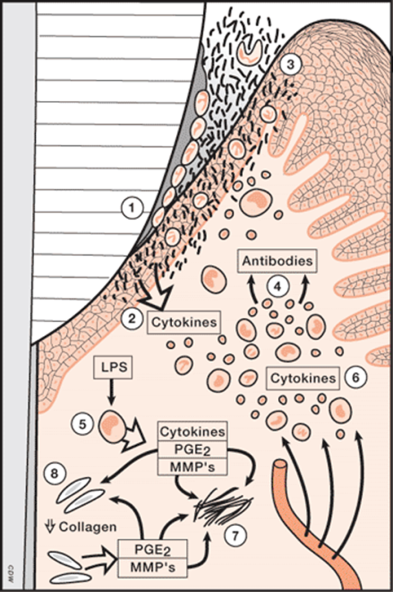
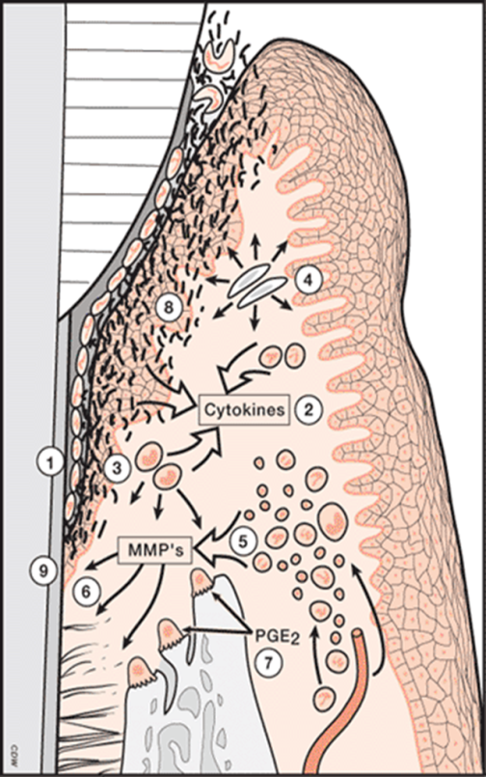
Periodontal Pocket Inflammation- A possible connection between Periodontal Disease and Cardiac Disease
2-4 days
4-7 days
14 days
Host dependent
Irreversible Damage
Reversible Condition

Slide 15
Periodontitis Influence on CRP Levels
An elevated CRP indicates inflammation somewhere in the body
47.2% of adults aged >30 years have periodontal disease
70.1% of adults >65 years have PD
There’s a good chance inflammation is in the mouth.
CRP levels have been shown to be up to 7 times higher in patients with periodontal disease.
Periodontal treatment lowers CRP levels
http://www.cdc.gov/oralhealth/periodontal_disease/

Slide 16
Schematic of Periodontal Disease
Periodontal pocket probe > 5mm
Loss of ligament attachment
Loose and/or sensitive teeth
Receding gumline
Prompt systemic response, elevates CRP
Notes:
50% of adults in US aged 30 or older have periodontitis
Only floss the teeth you want to keep

Slide 17
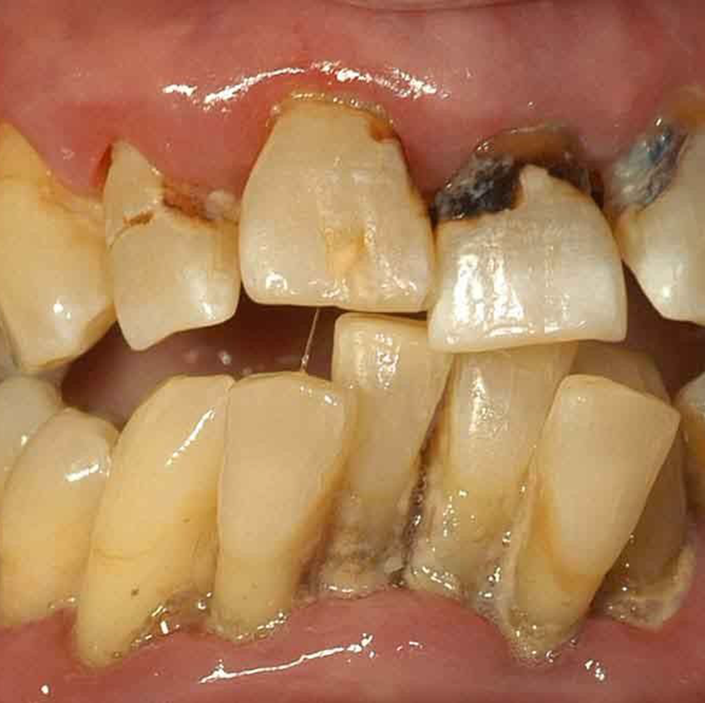
Periodontal Disease
Causes loss of attachments around teeth
Increased mobility – crowding, tooth loss
Root caries
Form in softer exposed roots of the teeth not protected with enamel
Difficult to fill, often require extraction

Slide 18
Cardiac Disease and Oral Health

Slide 19
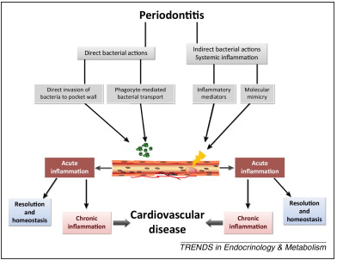
Proposed Mechanisms Linking PD and CVD
Karim El Kholy, Robert J. Genco, Thomas E. Van Dyke. (2015). Oral infections and cardiovascular disease, Volume 26, Issue 6, 2015, 315–321 http://dx.doi.org/10.1016/j.tem.2015.03.001
Notes:
Pathogens are carried through the bloodstream and inflammatory mediators from the liver injure the intimal lining of cardiac vessels leading to plaque formation

Slide 20
Chronic Inflammatory Diseases and CV Events
Jupiter trial – 1315 physicians and 26 countries with 11,001 males and 6,801 females
Would statin therapy reduce cardiac event rates among those with elevated high sensitivity C-reactive protein (hsCRP) >2mg/L but low levels of LDL <130mg/dL?
Participants randomized to rosuvastatin 20mg or placebo
Study stopped early
54% reduction in MI
48% reduction in stroke
46% reduction in all vascular events
20% reduction in all cause mortality
Conclusion: atherothrombosis is a disorder of inflammation and hyperlipidemia

Slide 21
What we do know…
Periodontal disease is associated with atherosclerotic cardiovascular disease, including coronary heart disease, cerebrovascular disease, and peripheral arterial disease
Severe periodontitis increases RISK of cerebral Ischemia by 4.3 times higher than people with mild or no periodontitis
Common oral problems - Periodontal disease, dental caries, missing teeth equal cholesterol levels in predicting cardiac disease
Katz J, Flugelman MY, Goldberg A, Heft M (2002). Association between periodontal pockets and elevated cholesterol and low density lipoprotein cholesterol levels. J Periodontol 73:494–500.

Slide 22
Ongoing Research Questions
Are there unidentified mechanisms by which periodontal bacteria are transported to vascular sites?
Does inflammation influence the type of bacteria deposited in atherosclerotic plaques?
Does CVD influence the presence or progression of periodontal disease?
Does treatment of periodontal disease influence the occurrence of primary myocardial infarctions?

Slide 23
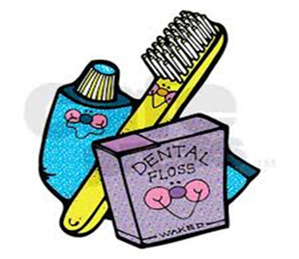
Managing Oral Disease
Prevention
Brushing twice daily
Daily flossing
Dental hygiene every 3-6 months
Treatment Options
Chlorhexidine 12% rinse 30 seconds and spit BID
An antibiotic rinse to be used until seen by dentist/dental hygienist
Stop immediately if causes dark brown staining of teeth
Available on $4 list at many pharmacies
Sodium Fluoride 1.1% toothpaste, use pea-sized amount BID
Added fluoride for exposed dental roots
Appointment with dentist or dental hygienist within 2-4 weeks

Slide 24
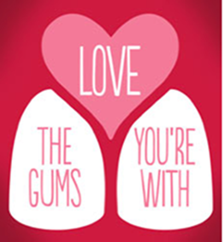
Clinical Practice Note
Assess gingiva of patients with high CV risk
No risk for patient
Potential for decreased cardiac risk
Refer to dental professionals for gingival disease
There is an association between CVD and PD; however, no direct link can be made

Slide 25
Dental Resources
FQHC settings
Dental Schools and Residencies
Dental Hygiene schools
Local Dentists

Slide 26
References
Batty, G. D., Jung, K. J., Mok, Y., Lee, S. J., Back, J. H., Lee, S., & Jee, S. H. (2018). Oral health and later coronary heart disease: cohort study of one million people. European journal of preventive cardiology, 25(6), 598-605.
D'Aiuto, F., Gkranias, N., Bhowruth, D., Khan, T., Orlandi, M., Suvan, J., ... & Mellor, T. (2018). Systemic effects of periodontitis treatment in patients with type 2 diabetes: a 12 month, single-centre, investigator-masked, randomised trial. The lancet Diabetes & endocrinology, 6(12), 954-965.
Dietrich, T., Webb, I., Stenhouse, L., Pattni, A., Ready, D., Wanyonyi, K. L., ... & Gallagher, J. E. (2017). Evidence summary: the relationship between oral and cardiovascular disease. British Dental Journal, 222(5), 381-385.
Eke, P. I., Thornton-Evans, G. O., Wei, L., Borgnakke, W. S., Dye, B. A., & Genco, R. J. (2018). Periodontitis in US adults: National health and nutrition examination survey 2009-2014. The Journal of the American Dental Association, 149(7), 576-588.
Gianos, E., Jackson, E. A., Tejpal, A., Aspry, K., O'Keefe, J., Aggarwal, M., ... & Fleisher, K. E. (2021). Oral health and atherosclerotic cardiovascular disease: A review. American Journal of Preventive Cardiology, 7, 100179.
Jain, S., Jain, K., & Patthi, B. (2019). Hemodialysis and Oral Health. In Renal Diseases. IntechOpen.
Karim El Kholy, Robert J. Genco, Thomas E. Van Dyke. (2015). Oral infections and cardiovascular disease, Volume 26, Issue 6, 2015, 315–321 http://dx.doi.org/10.1016/j.tem.2015.03.001
Katz J, Flugelman MY, Goldberg A, Heft M (2002). Association between periodontal pockets and elevated cholesterol and low density lipoprotein cholesterol levels. J Periodontol 73:494–500.
National Institutes of Health. Oral Health in America: Advances and Challenges. Bethesda, MD: US Department of Health and Human Services, National Institutes of Health, National Institute of Dental and Craniofacial Research, 2021.
Ridker, P. M. (2009). The JUPITER trial: results, controversies, and implications for prevention. Circulation: Cardiovascular Quality and Outcomes, 2(3), 279-285.

